Slide 1
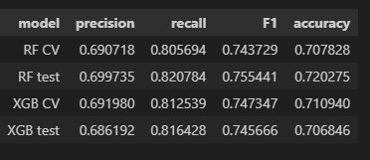
Machine Learning Model Outcomes
Executive summary report for the New York City Taxi and Limousine Commission
Prepared by Automatidata
New York City Taxi & Limousine Commission has contracted the Automatidata data team to build a machine learning model to predict whether a NYC TLC taxi cab rider will be a generous tipper.
After determining that predicting non-tippers could raise ethical concerns, the modeling objective was revised to identify “generous” tippers, defined as passengers who tip 20% or more. This revised objective aims to balance the interests of taxi drivers with fairness toward passengers, while still providing actionable insights.
The data team implemented and evaluated two different modeling approaches and compared their performance. However, neither model achieved strong predictive results. Consequently, the model is best suited as a tool for extracting business insights rather than as a reliable decision-making system, and should be used if at all as a
Behind the data
The data team hypothesized that trip itinerary, estimated fare amount, and time of day would be sufficiently related to tipping behavior to enable prediction of generous tippers.
The data team expected trip details, fare estimates, and time of day to strongly predict generous tipping, but model evaluation showed only moderate performance (test F1 ≈ 0.75), falling short of reliable real-world use.
Future model suggestions
Collect/add more granular driver and user-level data, including past tipping behavior.
Cluster with K-means and analyze the clusters to derive insights from the data
Results Summary
The resulting algorithm is usable to predict riders who might be generous tippers, but has serious limitations to its usability in informing business decisions. Refer to the “next steps” section for suggestions.
As a next step, the Automatidata data team could share the model results with the New York City Taxi and Limousine Commission, noting that the model should only be interpreted as a high-uncertainty indicator of tipping behavior. Substantial improvements in predictive performance would require additional data and further analysis.

